Slide 1
This session will be recorded
Recorded video will be available after this session

Slide 2
Machine Learning In GATE
Xingyi Song
13th GATE Course, Module 5

Slide 3
Some Terminology
Instance or Sample: is case that may be learned
Every instance is a decision for the ML algorithm to make
Represented by features
ML Model
Target 1
Instance
Label
Target 2
Loss

Slide 4
Some Terminology
Instance or Sample: is case that may be learned
Every instance is a decision for the ML algorithm to make
Represented by features
Feature: is an individual measurable property or characteristic of phenomenon being observed
ML Model
Target 1
Instance
Label
Target 2
Loss

Slide 5
Some Terminology
Instance or Sample: is case that may be learned
Every instance is a decision for the ML algorithm to make
Represented by features
Feature: is an individual measurable property or characteristic of phenomenon being observed
e.g. The word it self, the part-of-speech, length of the text
ML Model
Target 1
Instance
Label
Target 2
Token
Cases
Loss
Token Length
…...

Slide 6
Some Terminology
Target: is what we want to learn
The target can be
Categorical: finite number of categories or distinct groups (e.g. positive, negative)
Discrete: numeric variables that have a countable number of values between any two values
e.g. Covid cases
Continuous: numeric variables that have an infinite number of values between any two values
e.g. R0 value
ML Model
Target 1
Instance
Label
Target 2
Loss

Slide 7
Some Terminology
Label: is the “true” outcome of the target
Used in training phase
Supervised learning: label set = target set
Label set can be different to target set
Reinforcement learning
Unsupervised learning
ML Model
Target 1
Instance
Label
Target 2
Loss

Slide 8
Some Terminology
Loss Function: determine the error between model prediction and label
Guide model parameter update
ML Model
Target 1
Instance
Label
Target 2
Loss

Slide 9
Machine Learning in NLP
Classification
Group instances into predefined categories
Clustering
Group instances into undefined categories
Regression
Predict numeric variables

Slide 10
Classification
Most of the NLP tasks can be treated as classification task
Sentiment classification
Named entity recognition
Relation extraction
Information retrieval (learn to rank)
Machine translation
Dialogue system

Slide 11
Machine Learning in GATE
GATE supports machine learning in several ways
Learning Framework
Support Vector Machine
Decision Tree
Conditional Random Field
Maximum Entropy
Neural Network (CNN, LSTM, ELMO)
Neural Network Framework (under development)
Based on PythonPR
Focus Neural Network models
Currently support BERT classification
A few click machine learning solution

Slide 12
Language Classification
Language Classification
instance: Sentence annotation
features: Token annotations and their features
class: lang= “en”
Materials for this exercise are in the folder called “classification-hands-on”

Slide 13
Prepare for Training
Load Training Corpus
Right click “Language Resources” --> “New” --> “GATE Corpus”
(Optional) Name the corpus as train
Right click the “train” corpus --> “Populate”
For Directory URL, select folder “classification-hands-on/training-corpus”
Click OK

Slide 14
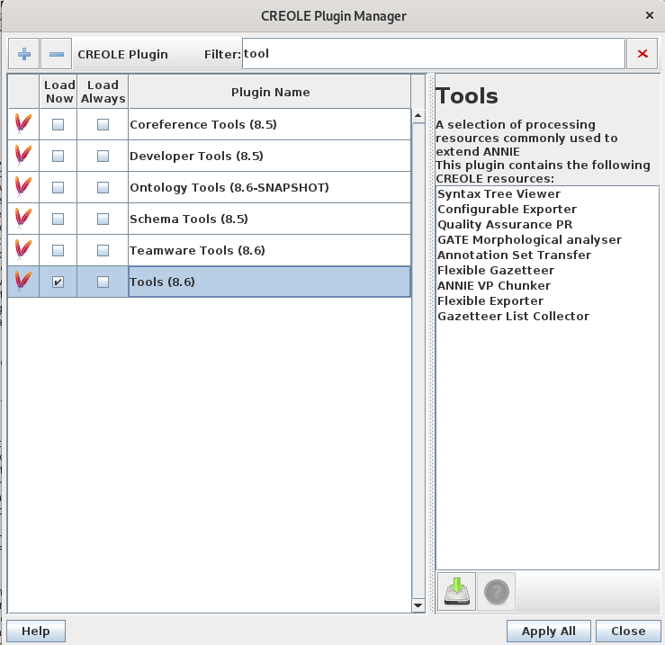
Prepare for Training
Load ANNIE to generate some features
Move the instance annotation to default set (same set as the ANNIE features)
Load “Tools” from CREOLE Plugin Manager
Right Click “Processing Resources”
“New” --> “Annotation Set Transfer”

Slide 15
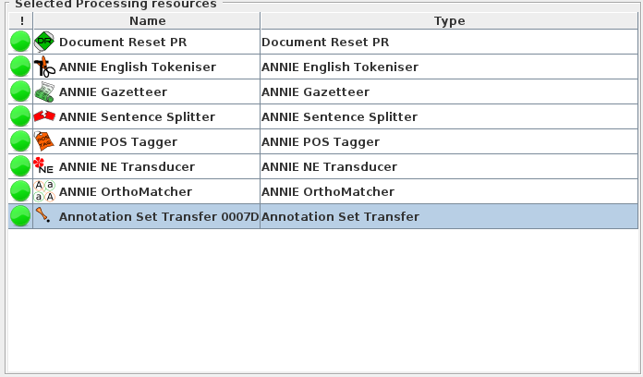
Prepare for Training
Load ANNIE to generate some features
Move the instance annotation to default set (same set as the ANNIE features)
Load “Tools” from CREOLE Plugin Manager
Right Click “Processing Resources”
“New” --> “Annotation Set Transfer”
Move “Annotation Set Transfer” to Pipeline

Slide 16
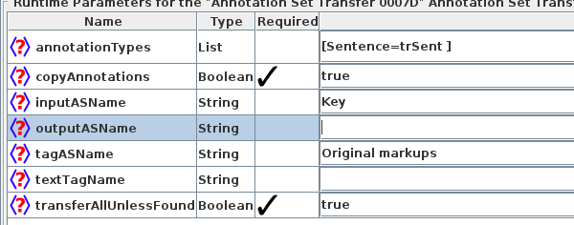
Annotation Set Transfer

Slide 17
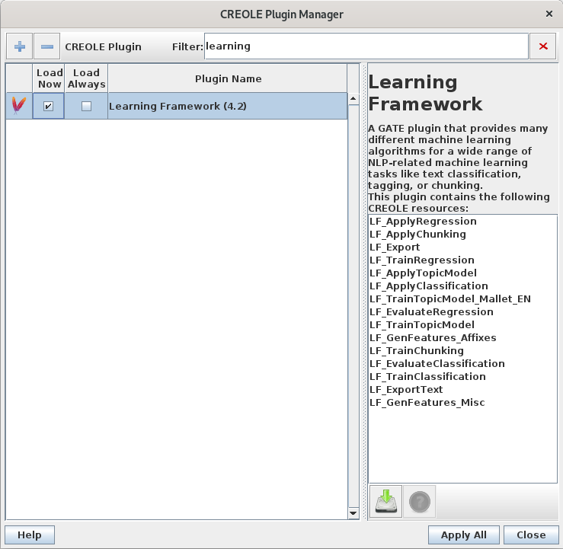
LF Classification
Load Learning Framework from CREOLE Plugin Manager

Slide 18
LF_TrainClassification
algorithmParameters: parameters influencing the training algorithm
dataDirectory: directory where to save all the files generated by the algorithm
featureSpecURL: the XML file describing the features to use
inputASName: input annotation set containing the instance annotations
instanceType: the annotation type of instance annotations
targetFeature: the feature on the instance annotation represents the class label
trainingAlgorithm: the classification training algorithm to use
instanceWeightFeature: a feature in the instance annotation that contains the instance weight
scaleFeatures: feature scale normalisation

Slide 19

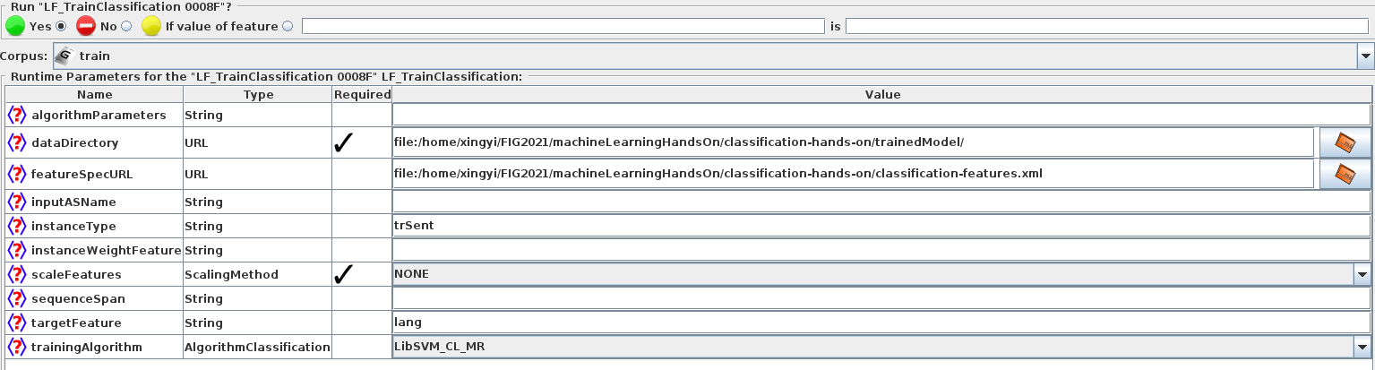
Load Training PR (Practical)
Right click “Processing Resources”
Select “LF_TrainClassification”
Add LF_TrainClassification to the Pipeline by using
Select the training corpus and click “Run this Application”

Slide 20
Classification Training
Short cut
Right click the “Applications”
Select “Restore Application from File”
Select “classification-hands-on/clsTrain.xgapp”

Slide 21
LF_ApplyClassification
algorithmParameters: parameters influencing the training algorithm
dataDirectory: the directory where the trained model is saved
inputASName: input annotation set containing the instance annotations
instanceType: the annotation type of instance annotations
targetFeature: the feature on the instance annotation represents the class label
scaleFeatures: feature scale normalisation
outputASName: the annotation set where the prediction will be placed

Slide 22
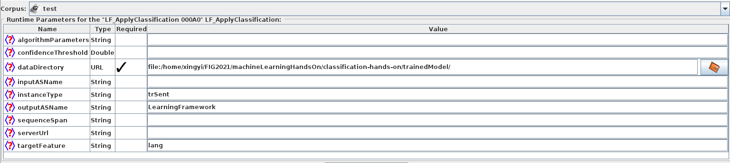
Apply Model (Practical)
Load another ANNIE (optional, you can rename it)
Right click “Processing Resources”
Select “LF_ApplyClassification”
Add LF_ApplyClassification to the Pipeline by using

Slide 23
Classification Application
Short cut
Right click the “Applications”
Select “Restore Application from File”
Select “classification-hands-on/clsApply.xgapp”

Slide 24
Improve Performance
Adding more features
Try different algorithms
Hyperparameter tuning
More data

Slide 25






More Features
5
Num. Legs | Num. Stic | Target
4 | 0 | no
2 | 1 | no
2 | 2 | no
4 | 4 | yes
4 | 5 | yes
3 | 5 | yes
4
Number of legs
3
2
1
1
2
3
4
5
Sticks chased

Slide 26
Improve Performance
Adding more features
Too many feature may also lead to overfitting
Some training algorithm less capable to handle large features
Try different algorithms
Hyperparameter tuning
Data

Slide 27
LF Classification Algorithm
Winnow
Linear classification method
Maximum entropy
Logistic regression with entropy loss
Support vector machine
Maximise the margin between pos and neg
Kernel trick for non-linear problem
Batch update, slow for large data
Naive Bayes Classifier
Based on Bayes’ Theorem (Generative model)
Decision tree
Explain with the trees
Neural network
Automatic (deep) feature generator

Slide 28
Hyperparameter Tuning
Hyperparameter: the parameters were decided by human e.g.
SVM: cost, kernel type
Neural Network: batch size, number of hidden layers and neurals
Hyperparameter Tuning normally based on validation set
There are some automatic hyperparameter tuning methods
e.g. Grid search

Slide 29
Data
More in domain data
Similar to testing data
Less noise
Class balance
Add weights to unbalanced data
Use relevant data
Transfer learning
Few-shot learning

Slide 30
LF_EvaluateClassification
LF_EvaluateClassification provide:
Automatic split training data into train and validation set
Cross validation or hold out
Not save trained model
Play with LF_EvaluateClassification
Load another ANNIE (optional, you can rename it)
Right click “Processing Resources”
Add “LF_EvaluateClassification”
Add “Annotation Set Transfer”
Add Annotation Set Transfer to the Pipeline by using
Add LF_EvaluateClassification to the Pipeline by using
Apply it to train corpus

Slide 31
LF_EvaluateClassification
algorithmParameters: parameters influencing the training algorithm
featureSpecURL: the XML file describing the features to use
inputASName: input annotation set containining the instance annotations
instanceType: the annotation type of instance annotations
targetFeature: the feature on the instance annotation represents the class label
trainingAlgorithm: the classification training algorithm to use
numberOfFolds: For cross-validation, how many folds to split the data into?
numberOfRepeats: For hold-out evaluation, the evaluation can be repeated across randomized splits
trainingFraction: For hold-out evaluation; in splitting off a training portion

Slide 32
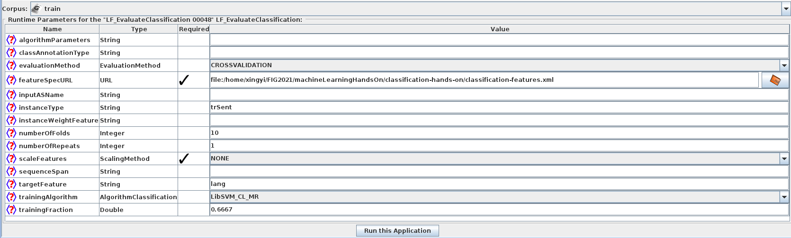
LF_EvaluateClassification

Slide 33
Classification Evaluation
Short cut
Right click the “Applications”
Select “Restore Application from File”
Select “classification-hands-on/clsEval.xgapp”

Slide 34
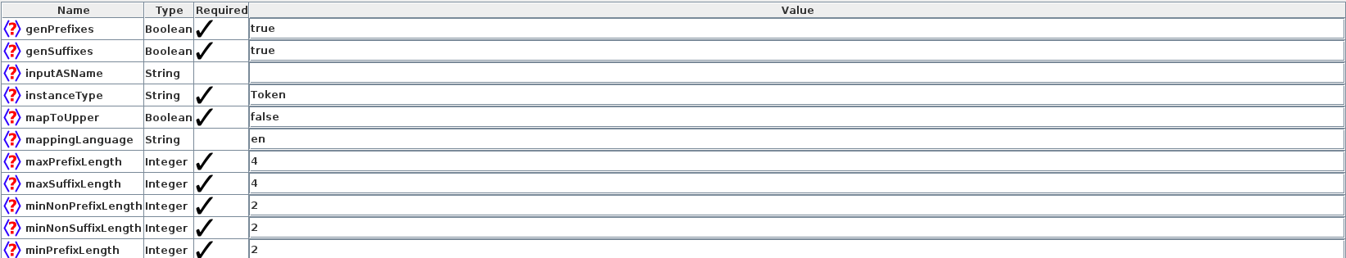
Adding Features
Right click “Processing Resources”
Select “LF_GenFeatures_Affixes”
Add LF_TrainClassification to the Pipeline by using
Before LF_EvaluateClassification
Set “genPrefixes” and “genSuffixes” to “true”

Slide 35
Adding Features
Double click the application
Select “LF_EvaluateClassification” in the pipeline
Change featureSpecURL to “classification-features_misc.xml”

Slide 36
Hyperparameters
LibSVM documentation: https://www.csie.ntu.edu.tw/~cjlin/libsvm/
Try to add algorithmParameters
c cost : set the parameter C of C-SVC, epsilon-SVR, and nu-SVR (default 1)
e.g. -c 2

Slide 37
Classification Evaluation
Short cut
Right click the “Applications”
Select “Restore Application from File”
Select “classification-hands-on/clsEval_affix.xgapp”

Slide 38
Chunking for NER
Chunking, means finding parts of text
Often used in Named Entity Recognition (NER)
e.g. person names in the text
Other tasks like
Negation range
Noun phrases
End-to-End aspect level sentiment analysis
The University of Sheffield is a public research university in Sheffield .
Orgnisation

Slide 39
Chunking
Chunking = Special classification task
Identify BIO labels of tokens
B= Beginning of the entity
I = Inside of the entity
O = Outside of the entity
The University of Sheffield is a public research university in Sheffield .
B
I
I
I
O
O
O
O
O
O
O
O
Orgnisation

Slide 40
BIO Classification
Classifier
B
Instance
I
Label
O
Token
Cases
Gradient
Loss
Token Length
…...

Slide 41
Sequence Classification
The University of Sheffield is a public research university in Sheffield .
B
I
I
I
O
O
O
O
O
O
O
O
Orgnisation
y(t-1)
y
y(t+1)
We need sequence information to classify BIO labels
Consider previous/after tokens as features
Use sequence classification algorithms
Consider sequence information in the algorithm
Conditional random fields
Recurrent Neural Network
Attention mechanism
x(t-1)
x
x(t+1)
y(t-1)
y
y(t+1)
x(t-1)
x
x(t+1)

Slide 42
Chunking Practical Exercise
Materials for this exercise are in the folder called “chunking-hands-on”
Finding Person Mentions using Chunking Training and Application PRs
You might want to start by closing any applications and corpora from the previous exercise, so we have a fresh start

Slide 43
Prepare for Training
Load Training Corpus
Right click “Language Resources” --> “New” --> “GATE Corpus”
(Optional) Name the corpus as train
Right click the “train” corpus --> “Populate”
For Directory URL, select folder “chunking-hands-on/training-corpus”
Click OK

Slide 44
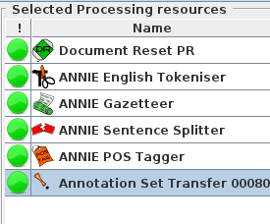
Prepare for Training
Load ANNIE to generate some features
Remove ANNIE NE Transducer and ANNIE OrthoMatcher
Because they are doing NER as well
Move the instance annotation to default set (same set as the ANNIE features)
Load “Tools” from CREOLE Plugin Manager
Right Click “Processing Resources”
“New” --> “Annotation Set Transfer”
Move “Annotation Set Transfer” to Pipeline

Slide 45
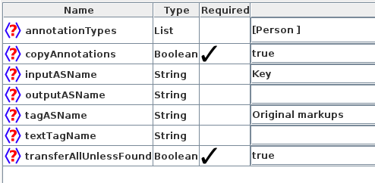
Annotation Set Transfer

Slide 46
LF_TrainChunking
algorithmParameters: parameters influencing the training algorithm
dataDirectory: directory where to save all the files generated by the algorithm
featureSpecURL: the XML file describing the features to use
inputASName: input annotation set containining the instance annotations
instanceType: the annotation type of instance annotations
classAnnotationType: the annotation type of the annotations which the model should learn
trainingAlgorithm: the classification training algorithm to use
sequenceSpan: specifies the span across which to learn a sequence

Slide 47
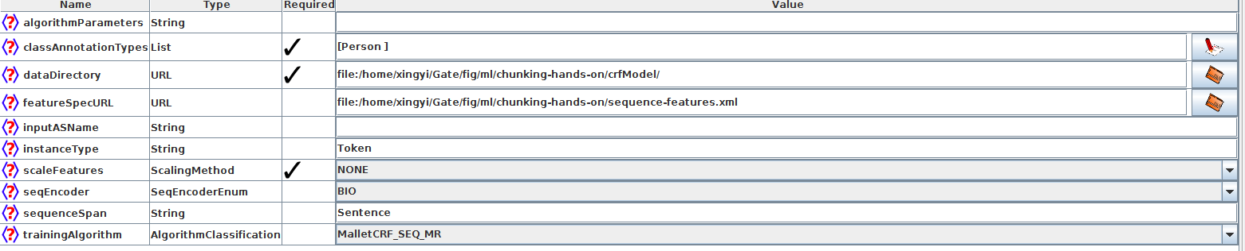
Load Training PR (Practical)
Right click “Processing Resources”
Select “LF_TrainChunking”
Add LF_TrainChunking to the Pipeline by using

Slide 48
NER Training
Short cut
Right click the “Applications”
Select “Restore Application from File”
Select “chunking-hands-on/nerTrain.xgapp”

Slide 49
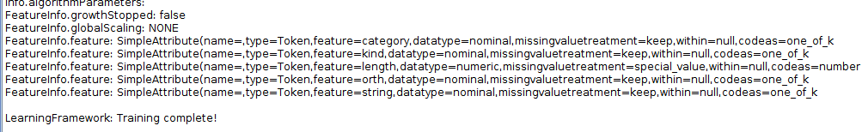
Train Model (Practical)
Select the training corpus and click “Run this Application”
After “Training complete”, you should have a new annotation set “LearningFramework” contains all ML output

Slide 50
LF_ApplyChunking
algorithmParameters: parameters influencing the training algorithm
dataDirectory: the directory where the trained model is saved
inputASName: input annotation set containining the instance annotations
instanceType: the annotation type of instance annotations
sequenceSpan: specifies the span across which to learn a sequence
confidenceThreshold: confidence score threshold required for a chunk to get assigned

Slide 51
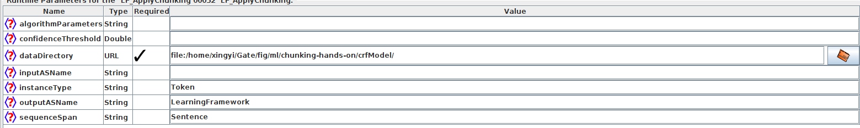
Apply Model (Practical)
Load another ANNIE (optional, you can rename it)
Right click “Processing Resources”
Select “LF_ApplyChunking”
Add LF_ApplyChunking to the Pipeline by using

Slide 52
NER Training
Short cut
Right click the “Applications”
Select “Restore Application from File”
Select “chunking-hands-on/nerApply.xgapp”

Slide 53
Evaluation
No reason to obtain accuracy over BIOs
More important measure how well finding named entities
Strict VS Lenient
we count an annotation as correct only if it has the same span as the gold standard annotation
Start and end off set have to be same
we allow an annotation that overlaps to be correct, even if it isn't a perfect span match
Overlap to label start and end off set
The University of Sheffield is a public research university in Sheffield .
B
I
I
I
O
O
O
O
O
O
O
O
Orgnisation
Strict
Lenient

Slide 54
Strict and Lenient
The
Taj
Mahal
Key: Location
Response: Location
The
government
of
Australia
Key: Organization
Response: Organization

Slide 55
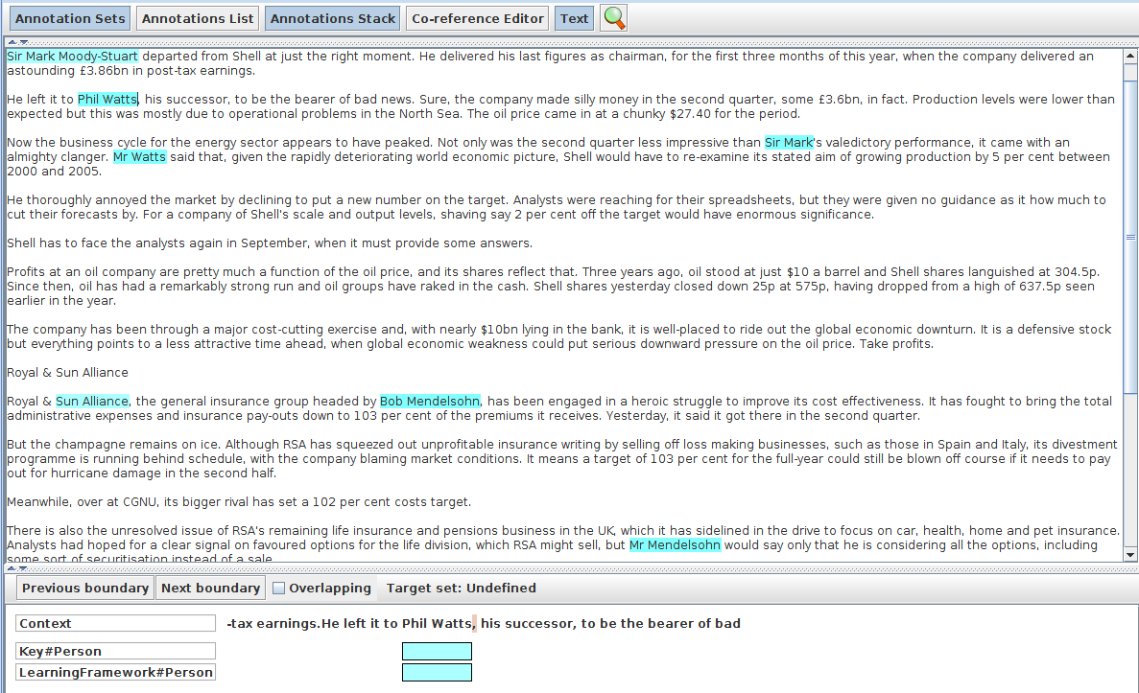
Exam Output (Practical)
You can manually compare the output with “Annotation Stack”

Slide 56
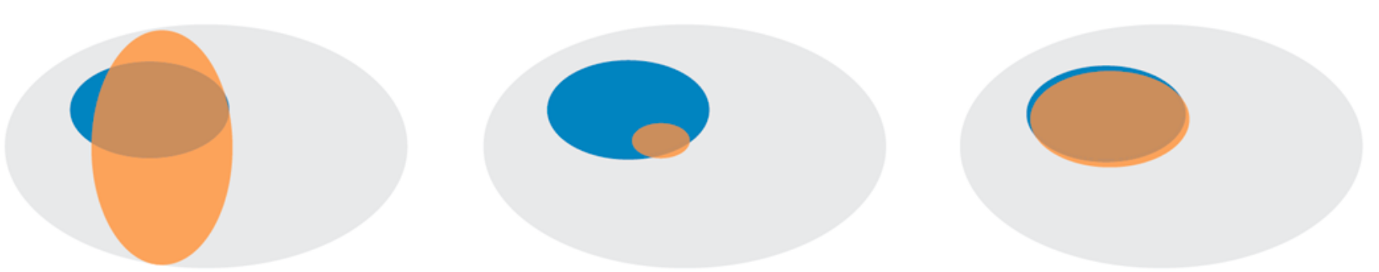
Precision and recall
Number of items correctly labelled as belonging to the positive class
Precision: divided by the total number of elements labelled as belonging to the positive class
Recall: divided by the total number of elements that actually belong to the positive class

Slide 57
F-measure
F-score is an amalgam of the two measures
Fβ = (1+β2)PR / (β2 P + R)
β controls the importance of Recall
The equally balanced F1 (β = 1) is the most common F-measure
F1 = 2PR / (P + R)

Slide 58
Scoring in GATE (Practical)
Select the test corpus and click on the “Corpus Quality Assurance” tab
Select the Key and LearningFramework annotation sets as A and B, respectively
Select the “Person” type
Choose an F-measure
Click on Compare

Slide 59
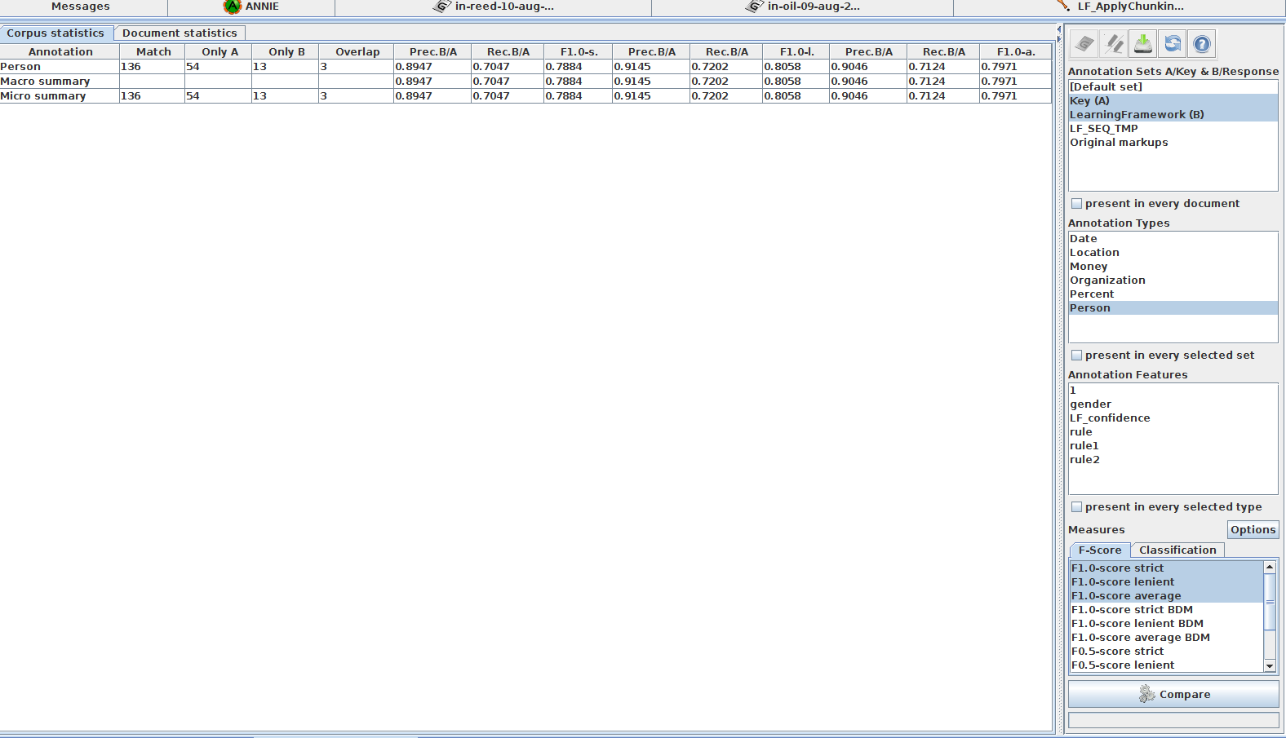
Scoring in GATE (Practical)

Slide 60
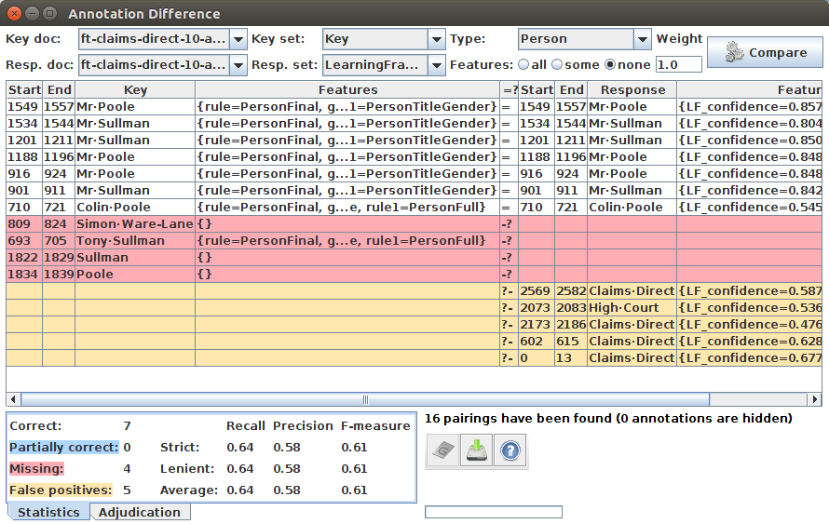
Annotation Diff Tool (Practical)
Choose a document you want to exam
Click to start annotation diff tool

Slide 61
Annotation Diff Tool (Practical)
“Correct”: the response annotation has the right feature and span
“Partially correct”: response has the right feature and overlapping but not exactly matched span; this counts as correct in the “lenient” scoring
“Missing”: key annotation+feature is missing from the response (a.k.a. “false negative”)
“False positive”: response annotation+feature shouldn't be there (a.k.a. “spurious”)

Slide 62
Neural Network Framework

Slide 63
Neural Network Framework
Neural Network Framework is based on Python PR
Python and libraries are required
A few click solution for the latest Neural Network models
Support BERT classification training and application

Slide 64
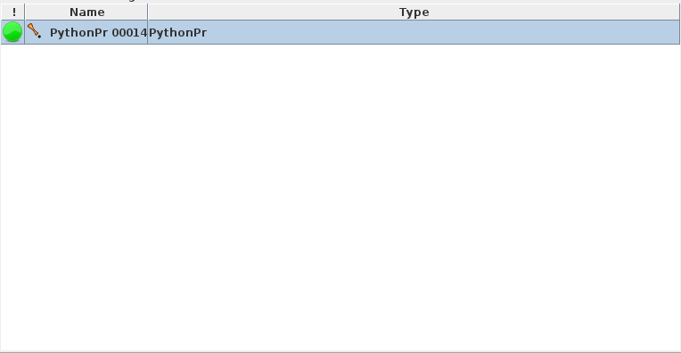
BERT Training
BERT is a pre-trained neural network (transformer) model
Generate deep feature it self

Slide 65
Play with BERT
Make sure you have Anaconda or Miniconda installed
Create conda environment by using
Windows: conda env create -f env_win.yml
Linux: conda env create -f env_lin.yml
You might need conda activate GATEPython before start the GATE
Load Python from CREOLE Plugin Manager

Slide 66
Load Training PR
Train BERT
Right Click “Processing Resources”
“New” --> “Python PR”
Select “NN_Framework/gateMLbertTrain.py”
Right Click “Applications”
“Create New Application” --> “Conditional Corpus Pipeline”
Add “Python PR” to the “Conditional Corpus Pipeline”

Slide 67
Language Classification
Language Classification
instance: Sentence annotation
features: Token annotations and their features
class: lang= “en”
Materials for this exercise are in the folder called “classification-hands-on”

Slide 68
Prepare for Training
Load Training Corpus
Right click “Language Resources” --> “New” --> “GATE Corpus”
(Optional) Name the corpus as train
Right click the “train” corpus --> “Populate”
For Directory URL, select folder “classification-hands-on/training-corpus”
Click OK

Slide 69
Prepare for Training
Load ANNIE to generate some features
Move the instance annotation to default set (same set as the ANNIE features)
Load “Tools” from CREOLE Plugin Manager
Right Click “Processing Resources”
“New” --> “Annotation Set Transfer”

Slide 70
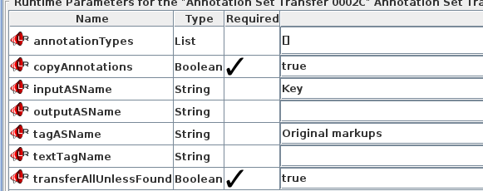
Prepare for Training
Load ANNIE to generate some features
Move the instance annotation to default set (same set as the ANNIE features)
Load “Tools” from CREOLE Plugin Manager
Right Click “Processing Resources”
“New” --> “Annotation Set Transfer”
Move “Annotation Set Transfer” to Pipeline

Slide 71
BERT Train
pythonBinary: If you installed the dependencies at non-default place (base), you need give the correct path
e.g. /home/xingyi/miniconda3/envs/GATEPython/bin/python
programParams:
batch_size: training batch size
gpu: use gpu for training
instanceType: the annotation type of instance annotations
model_path: path to save the trained model
splitValidation: split train/validation data for early stopping
targetFeature: the feature on the instance annotation represents the class label
targetFile: the file have labels for each document
workingSet: the input and output annotation set

Slide 72
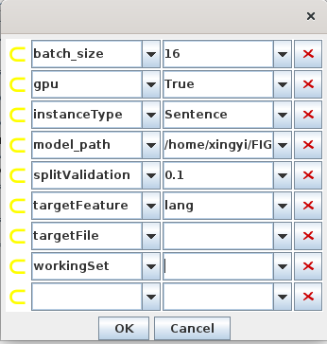
BERT Train
Shortcut xgapp file: NN_Framework/langBertTrain.xgapp
Keep GPU as False if you don't have GPU
Remember change the model path to your local directory

Slide 73
BERT Apply
pythonBinary: python binary path
programParams:
batch_size: training batch size
gpu: use gpu for training
instanceType: the annotation type of instance annotations
model_path: path to load the trained model
targetFeature: the feature on the instance annotation represents the class label
targetFile: the file have labels for each document (Load to GATE)
workingSet: the input and output annotation set
resultsExportFile: export results as tsv file
target2GateType: load the target feature to GATE document (work with targetFile only)

Slide 74
BERT Apply
Shortcut xgapp file: NN_Framework/langBertApply.xgapp
Keep GPU as False if you don't have GPU
Remember change the model path to your local directory

Slide 75
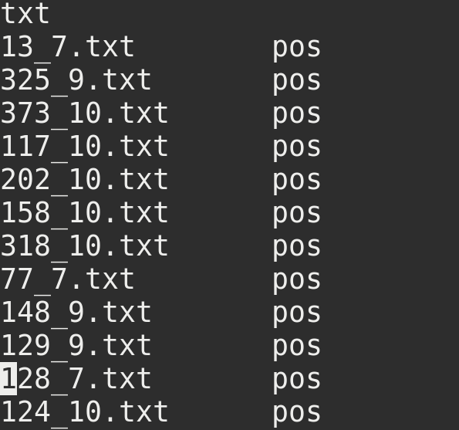
BERT Without GATE Annotation
IMDB example short cut
Right click the “Applications”
Select “Restore Application from File”
Select “NN_Framework/bertTrain.xgapp”
No GATE annotation
Use targetFile for target features
targetFile is tab splited file
First line is the file sufffix
Each line after is: file_name \t target

Slide 76
IMDB Apply
IMDB apply example short cut
Right click the “Applications”
Select “Restore Application from File”
Select “NN_Framework/bertApply.xgapp”
Export results:
Use resultsExportFile for results export
Output format as TSV
Each line format as: file_name start_off_set end_off_set prediction instance

Slide 77
GATE Machine Learning
Learning Framework: https://github.com/GateNLP/gateplugin-LearningFramework
Neural Network Framework: https://github.com/GateNLP/NN_Framework

Slide 78
Full Development Cycle
External Data
Train
Annotation Rules
Learning
Target
Training Set
Evaluation
Method 1
Raw Data
Labelled Data
Model
Validation Set
Test
Set
Evaluation Method 2

Slide 79
Annotation Rule
Why we need annotation rule
Human have different point of view on same thing
Annotation difference cause noise to data
Affect the learning
External Data
Train
Annotation Rules
Learning
Target
Training Set
Evaluation
Method 1
Raw Data
Labelled Data
Model
Validation Set
Test
Set
Evaluation Method 2

Slide 80
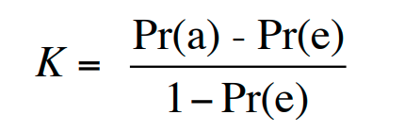
Data quality
We can measure the annotation agreement with Cohen’s Kappa
Pr(a) actual agreement
Pr(e) expected agreement

Slide 81
Split Dataset
Training Set: Training the mode parameters
Validation Set: Tune the hyperparameters
Test Set: Evaluate the performance
External Data
Train
Annotation Rules
Learning
Target
Training Set
Evaluation
Method 1
Raw Data
Labelled Data
Model
Validation Set
Test
Set
Evaluation Method 2

Slide 82
Evaluation Method 1
Normally called: Loss function or Cost function
Ideally
Differentiable: to calculate the gradient
Convex: not optimising local maximum
External Data
Train
Annotation Rules
Learning
Target
Training Set
Evaluation
Method 1
Raw Data
Labelled Data
Model
Validation Set
Test
Set
Evaluation Method 2

Slide 83
Evaluation Method 2
In human perspective
Evaluate the overall performance
External Data
Train
Annotation Rules
Learning
Target
Training Set
Evaluation
Method 1
Raw Data
Labelled Data
Model
Validation Set
Test
Set
Evaluation Method 2

Slide 84
External Data
We don't need to do all the hard work from scratch
Use exited similar data
Transfer learning
External Data
Train
Annotation Rules
Learning
Target
Training Set
Evaluation
Method 1
Raw Data
Labelled Data
Model
Validation Set
Test
Set
Evaluation Method 2

